Slide 1
Biostatistics
Week #17
6/14/2022

Slide 2
Chapter 17 – Correlation & Regression
Correlation (Pearson’s correlation coefficient)
Linear Regression
Multiple Regression

Slide 3
Introduction
To determine whether there is an association between two variables (one independent and one dependent)
If so, what is the association?
Can we use it to predict the weight of a male bear given his body length?
Lengths and Weights of Male Bears
x Length | 53.0 | 67.5 | 72.0 | 72.0 | 73.5 | 68.5 | 73.0 | 37.0
y Weight | 80 | 344 | 416 | 348 | 262 | 360 | 332 | 34

Slide 4
Correlation
A “correlation” can help determining whether there is a “statistically significant” association between two variables.
A scatter plot can help visually assessing whether the paired data (x, y) might be correlated.
Such correlation could be “linear” or in other nonlinear forms (such as exponential, etc.)

Slide 5
Linear correlation
The linear correlation coefficient r measures the strength of the linear association between the paired x- and y- quantitative values in a sample.
It is sometimes called Pearson product moment correlation coefficient.
r ranges between -1 and 1.

Slide 6
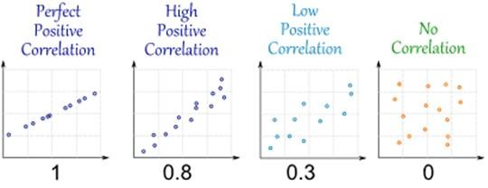
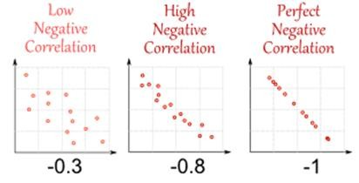

Slide 7
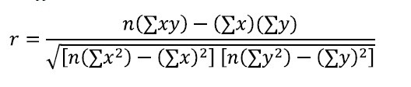
Basic requirements before computing r
paired data (x, y) are randomly sampled.
visual scatter plot be approximately a straight line.
outliners be firstly removed

Slide 8
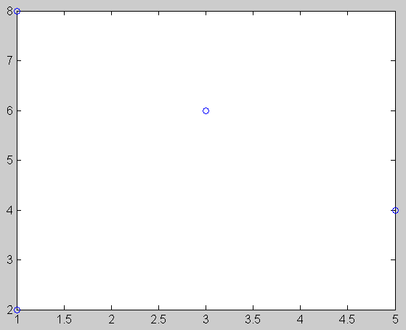
Example 1
Given the following 4 paired data, compute
the correlation coefficient r.
•
•
x | 1 | 1 | 3 | 5
y | 2 | 8 | 6 | 4
It looks like a low negative correlation.
r = -0.1348
•
•

Slide 9
>> x=[1 1 3 5];y=[2 8 6 4];n=4;
>> r=(n*sum(x.*y)- sum(x)*sum(y))/sqrt((n*sum(x.*x)-
sum(x)^2)*(n*sum(y.*y)-sum(y)^2))
r = -0.1348
>>

Slide 10
>> r=(n*sum(x.*y)-
sum(x)*sum(y))/sqrt((n*sum(x.*x)-
>> x=[1 1 3 5];y=[2 8 6 4];n=4;
sum(x)^2)*(n*sum(y.*y)-sum(y)^2))
r = -0.1348
Pay special attention to the usage of
computing those summations.
>>

Slide 11
>> r=(n*sum(x.*y)- sum(x)*sum(y))/sqrt((n*sum(x.*x)-
sum(x)^2)*(n*sum(y.*y)-sum(y)^2))
>> x=[1 1 3 5];y=[2 8 6 4];n=4;
r = -0.1348
Pay special attention to the usage of
computing those summations.
>>

Slide 12

Interpreting r
r is between -1 (perfect negative correlation) and +1 (perfect positive correlation).
r = 0 means no correlation.
Then what defines a “strong” correlation?
The absolute value of r should be no less than a critical value?
Is r a random variable having its own probability density function?

Slide 13

Hypothesis testing for r
H₀: no significant linear correlation
Test statistic t:
This is a 2-tailed t test
DF = n-2
α = 0.05 (usually)
r
1 − r²
n − 2
t =
p-value can be computed based on computed t on a t distribution of specific DF.
Reject if p <= 0.05.

Slide 14
Back to example 1 (n=4)
A critical t value that cuts 0.025 off the left tail of t_{DF=2} is “tinv(0.025, 2) = -4.3027”.
The t-statistic computed based on previously computed r = -0.1348 now becomes -0.1925.
-0.1925 is not as extreme or more extreme than -4.3027. We thus do not reject the null hypothesis of no significant linear correlation. 【There exists NO significant correlation~~~】
r
t =
1 − r²
n − 2
P-value = 2*tcdf(-0.1925,2)=0.8652, much greater than α=0.05.

Slide 15
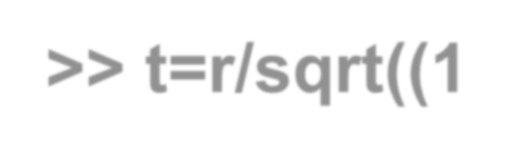

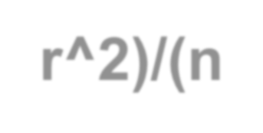
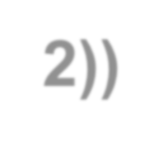
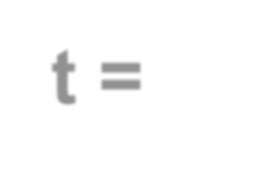
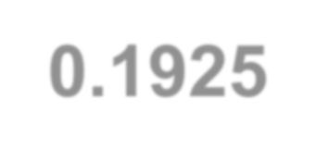

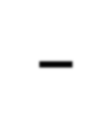


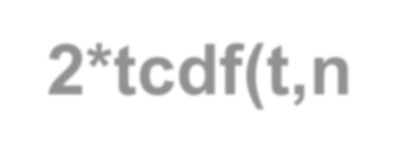



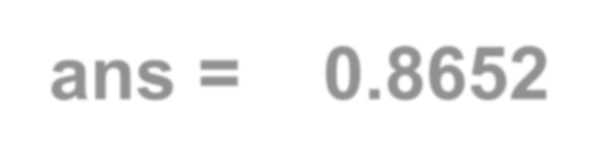
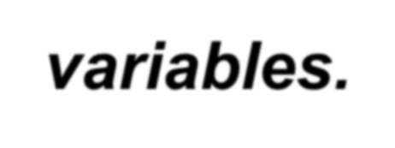
>> x=[1 1 3 5];y=[2 8 6 4];
>> n=4;
>> r=(n*sum(x.*y)- sum(x)*sum(y))/sqrt((n*sum(x.*x)-
sum(x)^2)*(n*sum(y.*y)-sum(y)^2))
r = -0.1348
>> t=r/sqrt((1-r^2)/(n-2))
t = -0.1925
>> 2*tcdf(t,n-2) ans = 0.8652
Conclusion – No correlation between the two variables.

Slide 16
Example 2
Find the linear correlation coefficient r for the following data.
Determine whether the correlation is significant or not by computing a critical r value and a p-value.
Lengths and Weights of Male Bears
x Length | 53.0 | 67.5 | 72.0 | 72.0 | 73.5 | 68.5 | 73.0 | 37.0
y Weight | 80 | 344 | 416 | 348 | 262 | 360 | 332 | 34

Slide 17
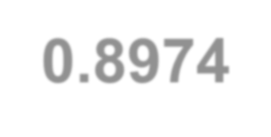
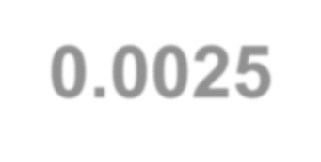
The computed r = 0.8974.
The computed t-statistic = 4.9807.
DF=8-2=6
A critical r cutting off 0.025 of the right tail of t_{DF=6} is “tinv(0.975, 6)=2.4469”. This is smaller than 4.9807. So our t-statistic is more extreme than expected.
P-value = “2*(1-tcdf(4.9807,6))=0.0025”.
We thus reject the null hypothesis, suggesting a significant linear correlation exists between the length and weight for male bears.

Slide 18
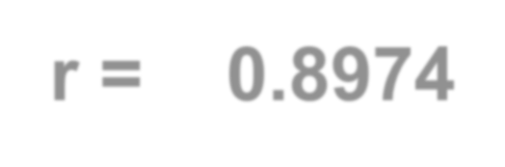
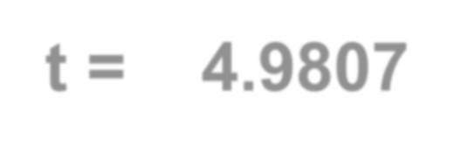

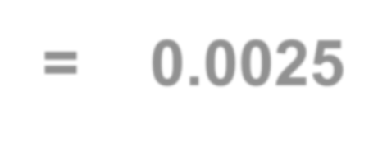
>> x=[53 67.5 72 72 73.5 68.5 73 37]; y=[80 344
416 348 262 360 332 34];n=8;
>> r=(n*sum(x.*y)- sum(x)*sum(y))/sqrt((n*sum(x.*x)-
sum(x)^2)*(n*sum(y.*y)-sum(y)^2))
r = 0.8974
>> t=r/sqrt((1-r^2)/(n-2))
t = 4.9807
>> 2*(1-tcdf(t,6))
ans = 0.0025
>>
_{t =} r
1 − r²
n − 2

Slide 19
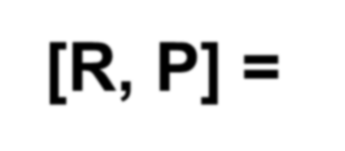

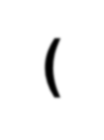
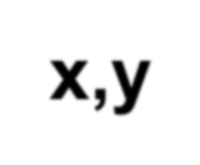
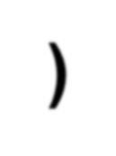


Using MATLAB’s “corrcoef” function
>> x=[53 67.5 72 72 73.5 68.5 73 37];
>> y=[80 344 416 348 262 360 332 34];
>> [R, P] = corrcoef(x,y)
R =
1.0000 0.8974
0.8974 1.0000
P =
1.0000 0.0025
0.0025 1.0000
Pearson coefficient
P-value in supporting the linear correlation at α=0.05.

Slide 20
Linear Regression
To find a graph and an equation of the straight line that represents the association.
The straight line is called “regression line”.
The equation is called “regression equation”.

Slide 21
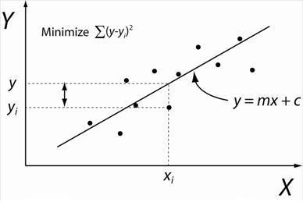
It’s all about finding the slope m and the y- intercept c of the straight line.

Slide 22
Example 3
Find the regression equation for the following data.
Predict the weight of a bear with x = 71.0.
Lengths and Weights of Male Bears
x Length | 53.0 | 67.5 | 72.0 | 72.0 | 73.5 | 68.5 | 73.0 | 37.0
y Weight | 80 | 344 | 416 | 348 | 262 | 360 | 332 | 34

Slide 23
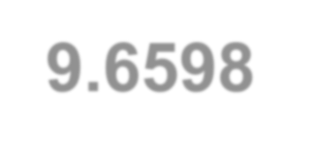

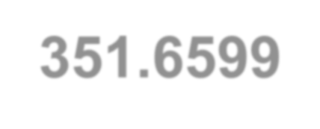



MATLAB’s “polyfit” (based on minimizing the least-squares of the errors) will serve the purpose.
>> x=[53 67.5 72 72 73.5 68.5 73 37];
>> y=[80 344 416 348 262 360 332 34];
>> polyfit(x,y,1) ans =
9.6598 -351.6599
>>
The equation is y = 9.6598x – 351.6599

Slide 24
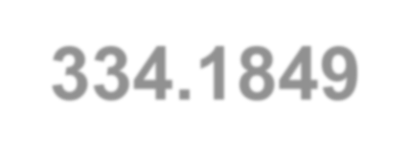
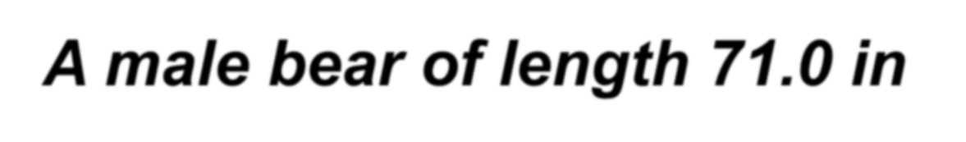

MATLAB’s “polyval” can be used to evaluate a value of a polynomial function.
>> x=[53 67.5 72 72 73.5 68.5 73 37];
>> y=[80 344 416 348 262 360 332 34];
>> polyfit(x,y,1) ans =
9.6598 -351.6599
>> polyval(polyfit(x,y,1), 71.0)
ans = 334.1849
>>
A male bear of length 71.0 in would weigh 334.1849 pounds.

Slide 25
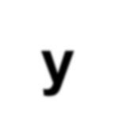
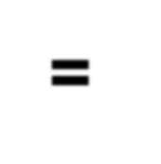
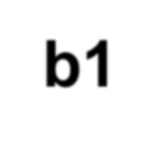
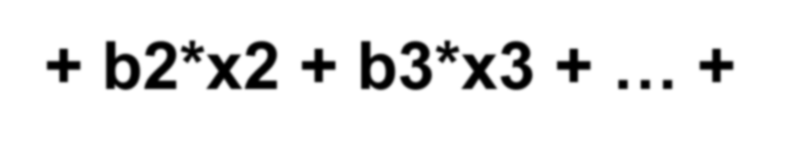
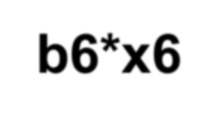
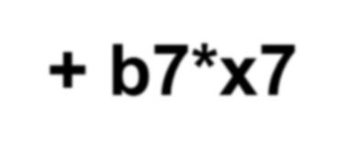
Multiple regression
Two or more independent variables.
Data from Male Bears
y Weight | 80 | 344 | 416 | 348 | 262 | 360 | 332 | 34
x2 Age | 19 | 55 | 81 | 115 | 56 | 51 | 68 | 8
x3 Head L | 11.0 | 16.5 | 15.5 | 17.0 | 15.0 | 13.5 | 16.0 | 9.0
x4 Head W | 5.5 | 9.0 | 8.0 | 10.0 | 7.5 | 8.0 | 9.0 | 4.5
x5 Neck | 16.0 | 28.0 | 31.0 | 31.5 | 26.6 | 27.0 | 29.0 | 13.0
x6 Length | 53.0 | 67.5 | 72.0 | 72.0 | 73.5 | 68.5 | 73.0 | 37.0
x7 Chest | 26 | 45 | 54 | 49 | 41 | 49 | 44 | 19
y = b1 + b2*x2 + b3*x3 + … + b6*x6 + b7*x7

Slide 26
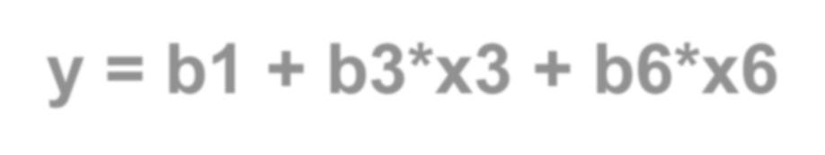
Example 4
Find b1, b3 and b6.
Data from Male Bears
y Weight | 80 | 344 | 416 | 348 | 262 | 360 | 332 | 34
x2 Age | 19 | 55 | 81 | 115 | 56 | 51 | 68 | 8
x3 Head L | 11.0 | 16.5 | 15.5 | 17.0 | 15.0 | 13.5 | 16.0 | 9.0
x4 Head W | 5.5 | 9.0 | 8.0 | 10.0 | 7.5 | 8.0 | 9.0 | 4.5
x5 Neck | 16.0 | 28.0 | 31.0 | 31.5 | 26.6 | 27.0 | 29.0 | 13.0
x6 Length | 53.0 | 67.5 | 72.0 | 72.0 | 73.5 | 68.5 | 73.0 | 37.0
x7 Chest | 26 | 45 | 54 | 49 | 41 | 49 | 44 | 19
y = b1 + b3*x3 + b6*x6

Slide 27
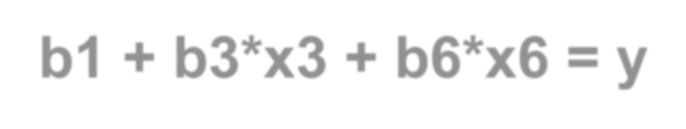
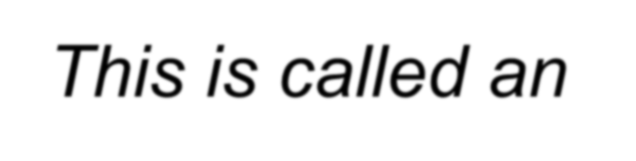

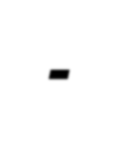


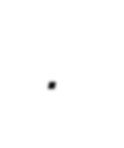
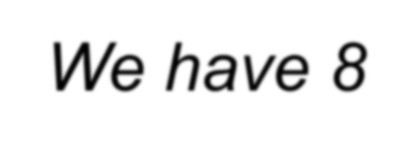
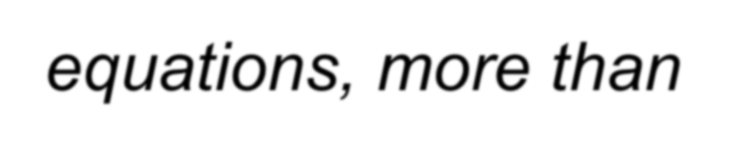
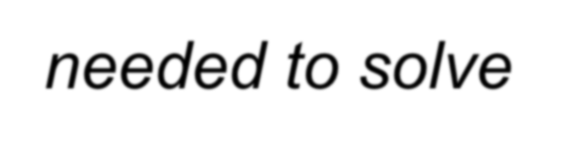
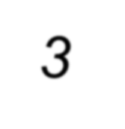
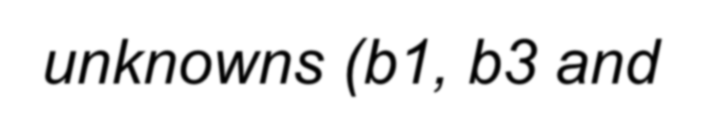
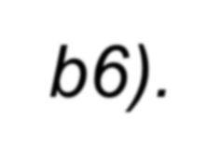
b1 + b3*x3 + b6*x6 = y
b1 + 11.0*b3 + 53.0*b6 = 80 b1 + 16.5*b3 + 67.5*b6 = 344 b1 + 15.5*b3 + 72.0*b6 = 416 b1 + 17.0*b3 + 72.0*b6 = 348 b1 + 15.0*b3 + 73.5*b6 = 262 b1 + 13.5*b3 + 68.5*b6 = 360 b1 + 16.0*b3 + 73.0*b6 = 332 b1 + 9.0*b3 + 37.0*b6 = 34
This is called an
over-determined
system. We have 8
equations, more than needed to solve 3 unknowns (b1, b3 and b6).
1 | 11.0 | 53.0 |  |  | 80
1 | 16.5 | 67.5 |  |  | 344
1 | 15.5 | 72.0 | b1 |  | 416
1 17.0 72.0 b3 = 348
1 15.0 73.5 b6 262
1 13.5 68.5 360
1 16.0 73.0 332
1 9.0 37.0 34
or AX = y

Slide 28
AX = y
[8 by 3][3 by 1] = [8 by 1]
The problem is – matrix A is not square. We cannot find its inverse and solve the equation as X=A⁻¹y.

Slide 29


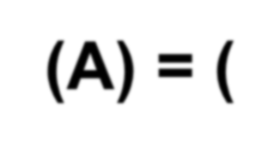




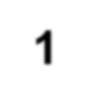
Pseudo-inverse of matrix A
X = pinv(A)y
[3 by 1] = [3 by 8] [8 by 1]
I need to have a “3 by 8” matrix which serves like an inverse of A. We call it a pseudo- inverse of matrix A, or pinv(A) = (A^{t}A)⁻¹A^{t} .
See Appendix for the definition of pinv(A)

Slide 30
Note that y, x3 and x6 must be column vectors.
>> y=[80 344 416 348 262 360 332 34]’;
>> x3=[11 16.5 15.5 17 15 13.5 16 9]’;
>> x6=[53 67.5 72 72 73.5 68.5 73 37]’;
>> A=[ones(size(x3)) x3 x6]
A =
53.0000 [8 by 3]
67.5000
72.0000
72.0000
73.5000
68.5000
73.0000
37.0000
1.0000 | 11.0000
1.0000 | 16.5000
1.0000 | 15.5000
1.0000 | 17.0000
1.0000 | 15.0000
1.0000 | 13.5000
1.0000 | 16.0000
1.0000 | 9.0000

Slide 31


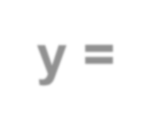
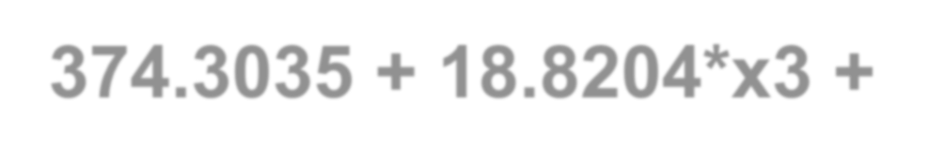
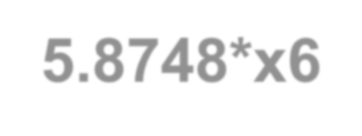
A‘ * A
[3 by 8] [8 by 3] = [3 by 3]
>> A'*A
ans = 1.0e+004 *
0.0008 | 0.0114 | 0.0517
0.0114 | 0.1667 | 0.7565
0.0517 | 0.7565 | 3.4526
pinv(A) = (A^{t}A)⁻¹A^{t}
(A^{t}A)⁻¹ *
_{A}t
>> pinvA=inv(ans)*A'
[3 by 8] = [3 by 3] [3 by 8]
pinvA =
0.8763 | -0.2719 | -0.2571 | -0.4628 | -0.2293 | 0.1123 | -0.3528 | 1.5853
-0.0983 | 0.1962 | -0.0209 | 0.1501 | -0.1123 | -0.1686 | 0.0132 | 0.0405
0.0100 | -0.0370 | 0.0105 | -0.0239 | 0.0302 | 0.0373 | 0.0045 | -0.0315
>> b=pinvA*y b = -374.3035 18.8204 |  | [3 by 1] = [3 by 8] [8 by 1] y = -374.3035 + 18.8204*x3 +
5.8748 >> |  | 5.8748*x6

Slide 32
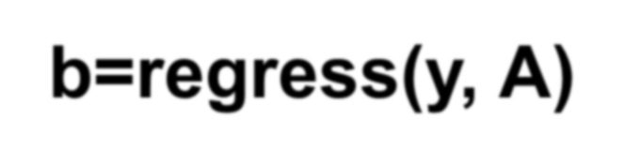
MATLAB’s “regress”
>> y=[80 344 416 348 262 360 332 34]’;
>> x3=[11 16.5 15.5 17 15 13.5 16 9]’;
>> x6=[53 67.5 72 72 73.5 68.5 73 37]’;
>> A=[ones(size(x3)) x3 x6];
>> b=regress(y, A)
b =
-374.3035
18.8204
5.8748
>>
Note that y, x3 and x6 must be column vectors in order to build the 8x3 matrix A.

Slide 33
In class practice – 1
What if we treat the first data point in
Example 1 as an outlier?
•
•
•
?
•
x | 1 | 1 | 3 | 5
y | 2 | 8 | 6 | 4

Slide 34
Cont’d
Compute the correlation coefficient r.
Compute the corresponding t- statistic t.
Compute the p-value for the null hypothesis that the two variables are not correlated.
Your conclusion?

Slide 35

In class practice – 2
Find b1, b2 and b6.
Data from Male Bears
y Weight | 80 | 344 | 416 | 348 | 262 | 360 | 332 | 34
x2 Age | 19 | 55 | 81 | 115 | 56 | 51 | 68 | 8
x3 Head L | 11.0 | 16.5 | 15.5 | 17.0 | 15.0 | 13.5 | 16.0 | 9.0
x4 Head W | 5.5 | 9.0 | 8.0 | 10.0 | 7.5 | 8.0 | 9.0 | 4.5
x5 Neck | 16.0 | 28.0 | 31.0 | 31.5 | 26.6 | 27.0 | 29.0 | 13.0
x6 Length | 53.0 | 67.5 | 72.0 | 72.0 | 73.5 | 68.5 | 73.0 | 37.0
x7 Chest | 26 | 45 | 54 | 49 | 41 | 49 | 44 | 19
y = b1 + b2*x2 + b6*x6

Slide 36
APPENDIX – LEAST SQUARE METHOD FROM LINEAR ALGEBRA

Slide 37




Least-Squares Curves
A system Ax = y of n equations in n variables, where A is invertible, has the unique solution x = A⁻¹y.
However, if the system has n equations and m variables, with n > m, the system does not, in general, have a solution and it is said to be over- determined.
A is not a square matrix, thus A⁻¹ does not exist.
A matrix called the pseudoinverse of A, denoted pinv(A), leads to a least-squares solution x = pinv(A)y for an over-determined system.
This is not a true solution, but in some sense the closest we can get in order to have a true solution.
37

Slide 38



DEFINITION：
Let A be a matrix, then the matrix (A^{t}A)⁻¹A^{t} is called a
pseudoinverse of A and is denoted pinv(A).
⎡ 1 2⎤
−1 3⎥
Example 1 Find the pseudoinverse of A =
⎢
_{2⎤}⎡
1 2⎤
⎣ 2 4⎦
⎡1 −1
2 3
⎡₆ ₇ ⎤
Solution
⎥
⎢
⎢
⎥
⎥
A^{t} A = ⎢
⎥⎢−1 3
=
⎣
₄ ⎢
⎥
⎢7
29⎥
⎣
adj( A^{t} A)
⎣
⎦
⎦⎢ 2 4⎥
⎦
1
1 ⎡ 29
( A^{t} A)⁻¹ =
_{A}t
− 7⎤⎡ 1 −1 6⎥⎦⎢⎣2 3
2⎤ ₌ 1 ⎡3
−10 6⎤
5 2⎥⎦
pinv( A) = ( A^{t} A)⁻¹ A^{t} = ^{1 ⎡ 29}
₄⎥⎦
125 ⎢⎣− 7
25 ⎢⎣1
38

Slide 39
System of Equations Ax = y
Ax = y
system
x = pinv(A)y
least-squares solution
Let Ax = y be a system of n linear equations in m variables with n＞m, where A is of rank m.
This system has a least-squares solution.
If the system has a unique solution, the least –squares solution is that unique solution.
If the system is over-determined, the least-squares solution is the closest we can get to a true solution.
The system cannot have many solutions.
39

Slide 40
Example 2
Find the least-squares solution to the following over-determined
system of equations. Sketch the solution.
x + y = 6
− x + y = 3 2x + 3y = 9
Solution
We have
1 1⎤
A = ⎢− 1 1⎥ a
⎡
(m=3, n=2)
⎢
_{2⎤}⎡
1 1⎤
⎡1 − 1
A^{t} A = ⎢
⎢−
⎣1
1
1 ⎡ 1
( A^{t} A)⁻¹ =
_{A}t
adj( A^{t} A
− 6⎤⎡1 −1 6⎥⎦⎢⎣1 1
−17 4⎤
30 ⎢⎣0 12 6⎥⎦
2⎤ ₌ 1 ⎡5
pinv( A) = ( A^{t} A)⁻¹ A^{t} = ^{1 ⎡ 11}
₃⎥⎦
30 ⎢⎣− 6
40

Slide 41

Then the least-squares solution is
1 ⎡5 −17
30 ⎣0 12
_{4⎤}⎡6⎤
⎥⎢₃⎥ _{= ⎢}
⎡1/ 2⎤
pinv( A)y =
⎢
⎥
_{6⎦}⎢ ⎥
⎣ ³ ⎦
⎢⎣9⎥⎦
The solution is shown below as point
P(¹ , 3).
2
41

Slide 42

Least Squares Curves
Least Squares Line
Least Squares Curve
The least squares line or curve can be found by solving a
over-determined system. This is found by minimizing the sum of
d₁² + d₂² +…+ d_{n}²
That’s where we get the name “least squares” from.
42

Slide 43
Example 3
Find the least-squares line for the following data points.
(1, 1), (2, 2.4), (3, 3.6), (4, 4)
Solution
Let the equation of the line be y = a + bx. Substituting for these points into the equation, we get an over-determined system:
a + b = 1
a + 2b = 2.4
a + 3b = 3.6
a + 4b = 4
⎡1 1⎤
⎢₁ ₂⎥
⎡
1⎤
To solve for the least-squares solution,
⎢2.4⎥
A = ⎢ ⎥ and y = ⎢
⎥
we have
⎢1 3⎥
⎢3.6⎥
⎢₁ ₄⎥
⎢ ₄⎥
⎣ ⎦
⎣ ⎦
Thus
10 0 −10⎤
20 ⎢⎣− 6 − 2 2
pinv( A) = ( A^{t} A)⁻¹ A^{t} = ^{1 ⎡ 20}
₆⎥⎦
43

Slide 44
And the least-squares solution is
1⎤
1 ⎡ 20 10
0 −10⎤⎡
⎡ 0.2 ⎤
⎢
−
[( A^{t} A) ¹ A^{t} ]y =
⎢
2.4
⎥
=
⎢
20 ⎣− 6 − 2 2 6
⎦
3.6
⎣1.02⎦
⎣ ⎦
4
Thus a = 0.2, b = 1.02.
And the equation is
y = 0.2 + 1.02x
y
(4, 4)
(3, 3.6)
(2, 2.4)
(1, 1)
x
44

Slide 45
Example 4
Find the least-squares parabola for the following data points.
(1, 7), (2, 2), (3, 1), (4, 3)
Solution
Let the parabola be y = a + bx + cx². Substituting data points:
a + b + c = 7
a + 2b + 4c = 2 a + 3b + 9c = 1 a + 4b +16c = 3
⎥ and
 | ⎡1 1 | 1⎤ | ⎡7⎤
 | ⎢1 2 A = ⎢ | ₄⎥ | ⎢₂⎥ _{y =} ⎢ ⎥
 | ⎢1 3 | 9⎥ | ⎢ 1⎥
 | ⎢1 4 | 16⎥ | ⎢₃⎥ ⎣ ⎦
pinv( A) = ( A^{t} A)⁻¹ A^{t} = ^{1 ⎡ 45 −15 −25 15⎤} _{20 ⎢⎣}−31 23 27 −19⎥⎦ 5 −5 −5 5
We have
⎣
⎦
45

Slide 46

Finally we have the solution
_{15⎤}⎡⁷⎤
⎡
[( A^{t} A)⁻¹ A^{t} ]y = ^{1 ⎡ 45 −15 −25}
⎢−31
Thus a = 15.25, b = −10.05,
c = 1.75.
y = 15.25 – 10.05x + 1.75x²
Or
y = 15.25 – 10.05x + 1.75x²
46

